Slide 1


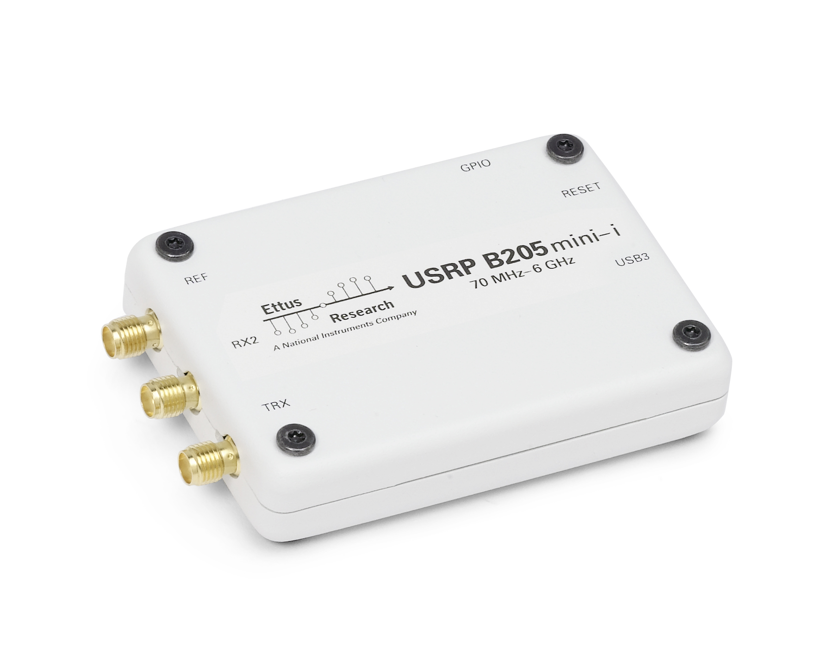
Two-Way USRP-LORAWAN
PC1 : LORAWAN NODE
PC2: LORAWAN Gateway
LORAWAN MAC Layer
A program in PC
Implemented In Eclipse
Packet Forwarder
A program in PC
Implemented In Eclipse
UDP
UDP
UDP
UDP
LORA modulation
Program In PC
Implemented In GNU RADIO
LORA modulation
Program In PC
Implemented In GNU RADIO
USB
USB
USRP: Frequency Translation
USRP: Frequency Translation

